Slide 1
IBM Data Science Professional Certificate
Prediction of Accident Severity

Slide 2
Predict the Car Accident Severity
Road accidents are a serious concern for the majority of nations around the world because accidents can cause severe injuries and fatalities.
According to the World Health Organization’s Global Status Report, approximately 1.25 million people deaths happened per year are because of road accident injuries, and most fatality rates were in lower income countries
Our motivation is to predict the accident severity of any road, which will play a crucial factor for traffic control authorities to take proactive precautionary measures.
This machine learning pipeline will be exploring whether weather, light, and road conditions – that increase the amount of information available about the situation – can increase the accuracy of predicting the severity of an accident.

Slide 3

Data Acquisition
Dataset Used :
Data has been fetched from Open Data platform UK. It Captures Road Accidents in UK between 1979 and 2015 has 70 features/columns and about 250K rows.
It has around 70 features/Columns and about 250K rows.
The Data set contains column including weather conditions, Road class, road type, junction details, road surface conditions, light conditions, etc.
Data has been fetched from Open Data Platform UK and is being shared under Open Government License.
We have cleaned data for further analysis using different methods.

Slide 4
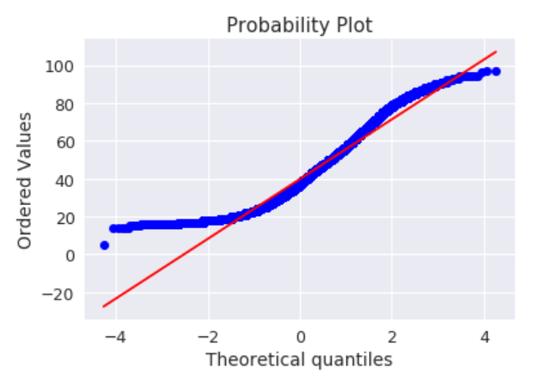
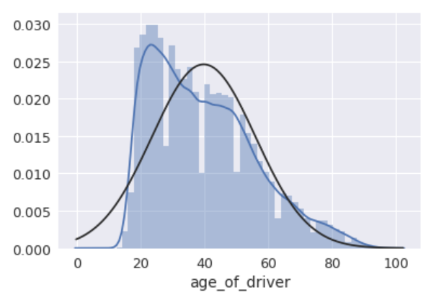
Legacy Data Enrichment
taking the logarithm of both the age of the driver and age of the vehicle improved the fit by altering the scale and making the variables more "normally" distributed.

Slide 5
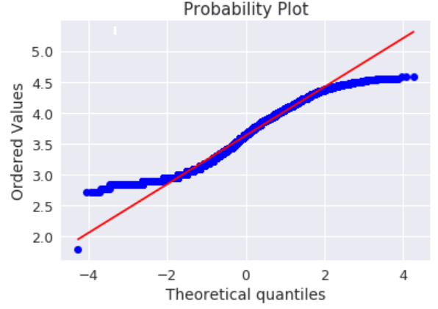
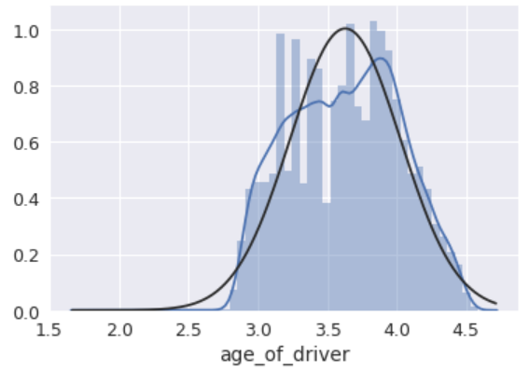
Alteryx Workflow
The increases the performance of machine learning algorithms, as the numerical values do not have disproportionate amounts of computing value compared to all the other categorical variables.

Slide 6
Score
Machine Learning algorithm scores without weather related conditions |  | Machine Learning algorithm scores without weather related conditions
Model | Score | Model | Score
Logistic Regression | 92.47 | Logistic Regression | 92.47
Random Forest | 92.26 | Random Forest | 92.59
Support Vector Machines | 92.06 | Support Vector Machines | 92.12
Stochastic Gradient Decent | 92.06 | Stochastic Gradient Decent | 92.04
Linear SVC | 92.06 | Linear SVC | 92.06
Perceptron | 92 | Perceptron | 92.06
KNN | 90.4 | KNN | 90.2
Naive Bayes | 90 | Naive Bayes | 87.94
Decision Tree | 86.4 | Decision Tree | 86.18

Slide 7
Technologies & Tools used
For developing this project, below tools and technologies have been used.
Python: Python is easy to understand language and has a rich set of libraries to use for data pre-processing, modelling, and evaluating the algorithms. Moreover, python has very good community support which is very useful for debugging the code.
Jupyter Notebook: Jupyter notebook is a simple and interactive tool for running python code. Also, it has many different sets of features such as downloadable to .py, .ipynb, and .html files.
For publishing all Notebook and Reports : Github

Slide 8
Conclusion and Future work:
The results indicated that adding weather-related features to a machine learning algorithm in predicting severity of an accident did not change the accuracy of the model. When adding three features of light condition, weather condition, and the condition of the road surface, the measures of recall, precision, and f1-score remained unchanged.
When looking at the overall performance of all the algorithms, there was an increase in accuracy between the data with weather conditions when compared to data without weather related conditions. Namely, random forest algorithm increased performance by 0.59%. The previous top performer when no weather-related conditions were introduced, Logistic Regression, sustained the same level of accuracy. Hence, it was concluded to further scrutinize the recall, precision, and f1-score of random forest algorithm to see whether there was an actual change in prediction power.

Slide 9

Thank you

